Slide 1
Spatial Transformer Networks
Jaderberg, Max, Karen Simonyan, and Andrew Zisserman.
Advances in neural information processing systems 28 (2015).
2022.11.11
Advanced Computer Vision
KENTECH Energy AI
VIEW Lab
Sohee Kim
Notes:
https://towardsdatascience.com/review-stn-spatial-transformer-network-image-classification-d3cbd98a70aa

Slide 2
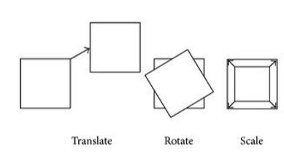
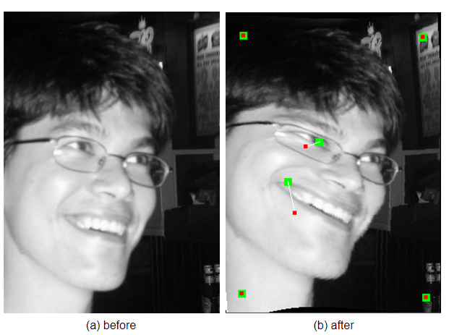
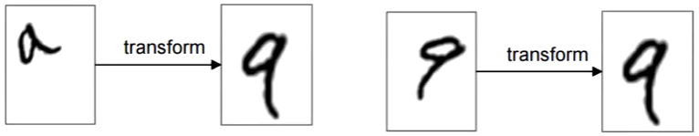
Jaderberg, Max, Karen Simonyan, and Andrew Zisserman. "Spatial transformer networks." Advances in neural information processing systems 28 (2015).
Introduction
The Convolutional Neural Network (CNN) define an exceptionally powerful class of models, but has Limitation : lack of ability to be Spatially invariant to the input data == invariance of the model towards spatial transformations of images (rotation, translation, scaling)
Max-pooling layer – satisfy this, but 2x2 pixel-wise operation is difficult to cope with various spatial variability
Spatial transformer module – include in to standard neural network
Spatial transformer module
A learnable module that can be placed in a CNN, to increase the spatial invariance in an efficient manner
A dynamic mechanism – unlike pooling layer (receptive fields are fixed and local)
Input image → transformation is performed on the entire feature map (can include scaling, cropping, rotations, non-rigid deformations)
Networks select regions that are most relevant(attention), transform those regions to a canonical(일반적인) pose
https://towardsdatascience.com/review-stn-spatial-transformer-network-image-classification-d3cbd98a70aa
Notes:
Convolutional Neural Networks define an exceptionally powerful class of models, but are still limited by the lack of ability to be spatially invariant to the input data in a computationally and parameter efficient manner.
Spatial invariance refers to the invariance of the model towards spatial transformations of images such as rotation, translation and scaling.
Non rigid – change in shape or size 모양, 크기 변형
Rigid – change in location and orientation 위치, 방향 변형

Slide 3
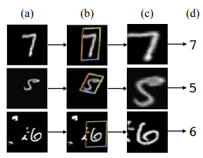
Jaderberg, Max, Karen Simonyan, and Andrew Zisserman. "Spatial transformer networks." Advances in neural information processing systems 28 (2015).
Introduction
Image classification Using Spatial Transformer
> Result using a spatial transformer as the first layer of a FC network trained for distorted MNIST digit classification
The action of the spatial transformer is conditioned on individual data samples, trained well without extra supervision
Can be trained with standard back-propagation (allowing end-to-end training of models)
Can be added into CNNs to help with a variety of tasks (image classification, co-localization, spatial attention)
The framework they present in this paper can be seen as a generalisation of differentiable attention to any spatial transformation
Classification
prediction
Input of
spatial transformer
Prediction (Localization
network)
Output of
spatial transformer
> distorted(왜곡됨)
→ Fully-connected network
Notes:
In this work, we aim to achieve invariant representations by manipulating the data rather than the feature extractors, something that was done for clustering in [7].

Slide 4
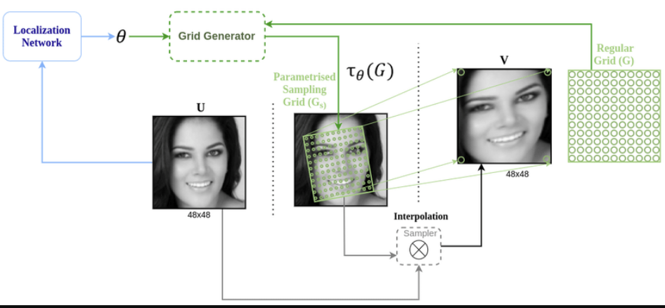
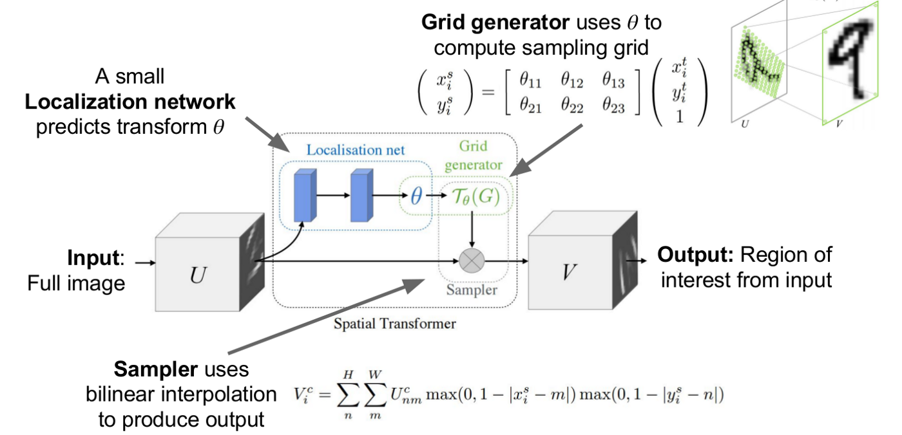
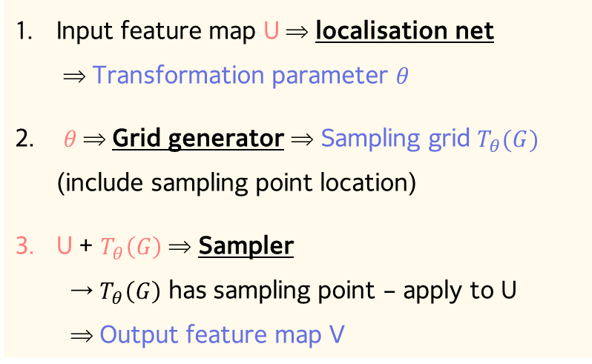
Jaderberg, Max, Karen Simonyan, and Andrew Zisserman. "Spatial transformer networks." Advances in neural information processing systems 28 (2015).
Spatial Transformers
Spatial Transformer
Localisation network
Grid generator
Sampler
(W x H x Ch x Batch size)
Input feature map U ⇒ localisation net ⇒ Transformation parameter $θ$
$θ$⇒ Grid generator ⇒ Sampling grid $T_{θ}(G)$ (include sampling point location)
U + $T_{θ}\left(G\right)$ ⇒ Sampler
→ $T_{θ}\left(G\right)$ has sampling point – apply to U ⇒ Output feature map V
https://manjunathbhat9920.medium.com/spatial-transformer-network-82666f184299
Notes:
STN is composed of Localisation Net, Grid Generator and Sampler.

Slide 5
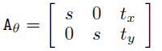
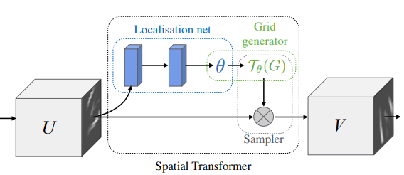
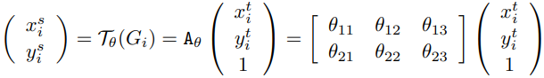
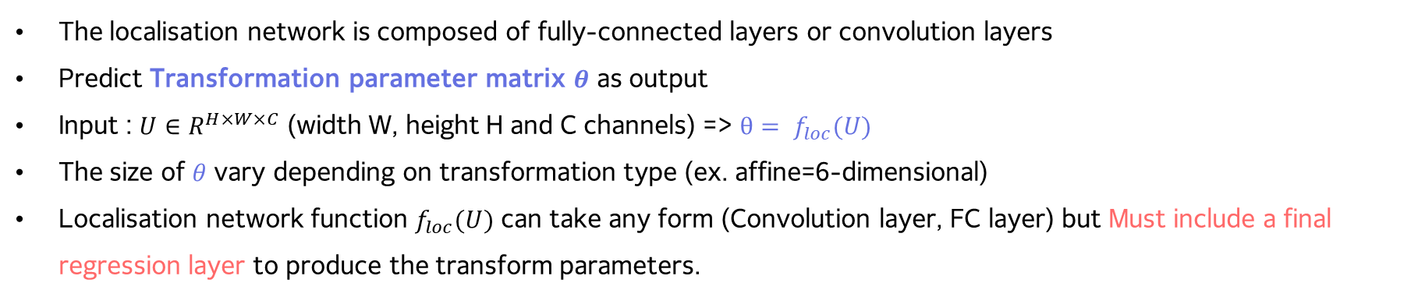
Jaderberg, Max, Karen Simonyan, and Andrew Zisserman. "Spatial transformer networks." Advances in neural information processing systems 28 (2015).
Spatial Transformers
Localisation network
The localisation network is composed of fully-connected layers or convolution layers
Predict Transformation parameter matrix $θ$ as output
Input : $U∈R^{H×W×C}$ (width W, height H and C channels) => $θ= f_{loc}(U)$
The size of $θ$ vary depending on transformation type (ex. affine=6-dimensional)
Localisation network function $f_{loc}(U)$ can take any form (Convolution layer, FC layer) but Must include a final regression layer to produce the transform parameters.
> Only scaling + translation
Transformation parameter matrix

Slide 6
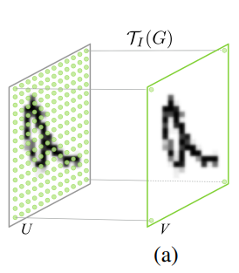
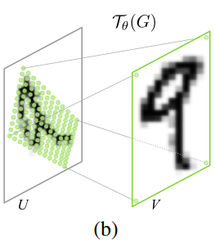
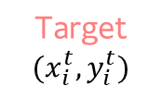
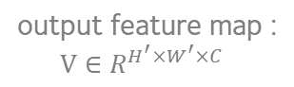
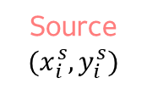
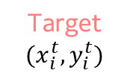
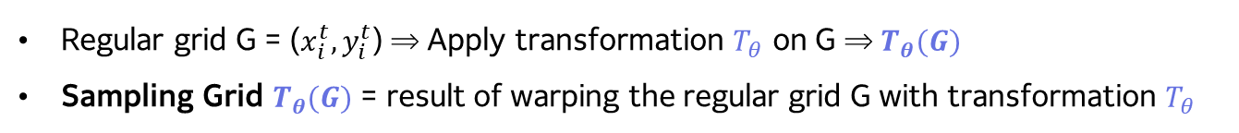
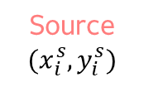


Jaderberg, Max, Karen Simonyan, and Andrew Zisserman. "Spatial transformer networks." Advances in neural information processing systems 28 (2015).
Spatial Transformers
2. Parameterised Sampling Grid
Regular grid G = ($x_{i}^{t},y_{i}^{t}$) ⇒ Apply transformation $T_{θ}$ on G ⇒ $T_{θ}(G)$
Sampling Grid $T_{θ}(G)$ = result of warping the regular grid G with transformation $T_{θ}$
Grid generator – Identity transformation
Grid generator – Affine transformation
Source
$$(x_{i}^{s},y_{i}^{s})$$
Target
$$(x_{i}^{t},y_{i}^{t})$$
Target
$$(x_{i}^{t},y_{i}^{t})$$
Source
$$(x_{i}^{s},y_{i}^{s})$$
output feature map : $V∈R^{H^{′}×W^{′}×C}$
Sampling Grid :
Regular grid $G= T_{I}(G)$
Sampling Grid : $G= T_{θ}(G)$
Notes:
Identity transformation – 항등변환 (변환 결과가 자기 자신이 나오는 변환)
Affine transformation – 아핀 변환 (점, 직선, 평면을 보존. 평행선이 보존된다.)
The sampling grid is the result of warping the regular grid with an affine transformation Tθ(G).
G : a set of points with target coordinates (xt_i, yt_i).
After Tθ(G), a set of points with destination coordinates (xt_i, yt_i) is outputted

Slide 7
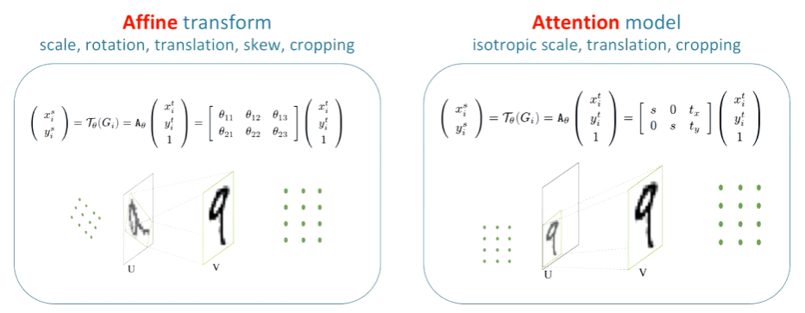
Jaderberg, Max, Karen Simonyan, and Andrew Zisserman. "Spatial transformer networks." Advances in neural information processing systems 28 (2015).
Spatial Transformers
2. Parameterised Sampling Grid
The transformation can have any parameterised form, provided that it is differentiable with respect to the parameters
Grid generator Examples
Affine Transformation
Attention Transformation
Source value
Target value
https://www.youtube.com/watch?v=Rv3osRZWGbg
Notes:
- Attention model
Isotropic scale : 가로 세로 동일한 비율의 변환
파라미터 3개만 사용
$T_{θ}$의 각 parameter 들에 대해서 미분가능하기만 하면 이외에 어떠한 parameterized form의 변환도 가능

Slide 8
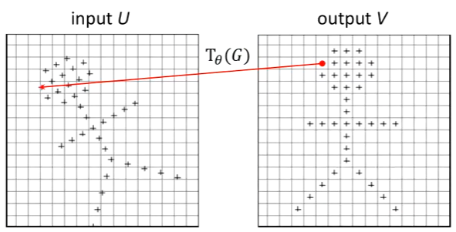
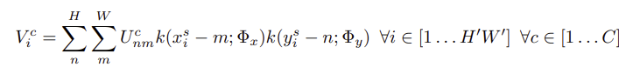
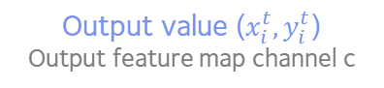
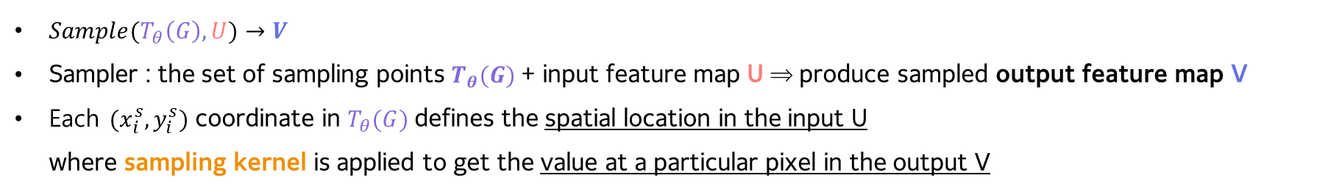
Jaderberg, Max, Karen Simonyan, and Andrew Zisserman. "Spatial transformer networks." Advances in neural information processing systems 28 (2015).
Spatial Transformers
3. Differentiable Image Sampling
$Sample(T_{θ}\left(G\right),U)→V$
Sampler : the set of sampling points $T_{θ}(G)$+ input feature map U ⇒ produce sampled output feature map V
Each $(x_{i}^{s},y_{i}^{s})$ coordinate in $T_{θ}(G)$defines the spatial location in the input U where sampling kernel is applied to get the value at a particular pixel in the output V
With high probability, location points are not an exact integer (like (1, 2)) → need interpolation of surrounding values
Any sampling kernel can be used.
Interpolation function: Sampling kernel k()
Parameters of k()
Output value ($x_{i}^{t},y_{i}^{t}$)
Output feature map channel c
Input value
(n,m) value
Sampling grid coordinate
> General form
https://jamiekang.github.io/2017/05/27/spatial-transformer-networks/
Notes:
To perform a spatial transformation of the input feature map, a sampler must take the set of sampling points Tθ(G), along with the input feature map U and produce the sampled output feature map V .
Each (x s i , ys i ) coordinate in Tθ(G) defines the spatial location in the input where a sampling kernel is applied to get the value at a particular pixel in the output V.
where Φx and Φy are the parameters of a generic sampling kernel k() which defines the image interpolation (e.g. bilinear), U c nm is the value at location (n, m) in channel c of the input, and V c i is the output value for pixel i at location (x t i , yt i ) in channel c.
Note that the sampling is done identically for each channel of the input, so every channel is transformed in an identical way (this preserves spatial consistency between channels).
위치가 정확히 정수 좌표 값을 가지지 않을 가능성이 더 높기 때문에, 주변 값들의 interpolation을 통해 값을 계산
Why do we need interpolation
회전하기 전에 포인트 => 정수 값이 아님

Slide 9
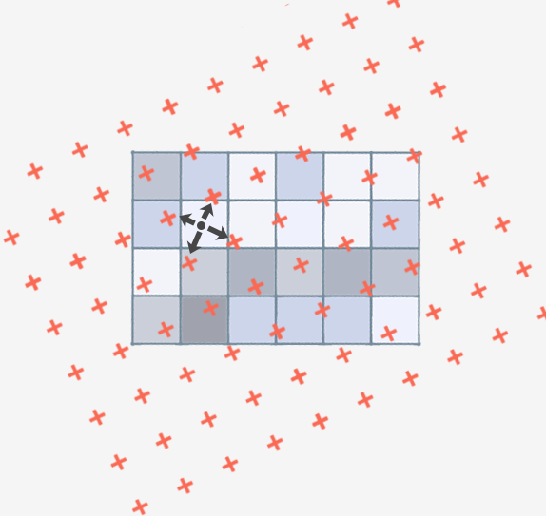
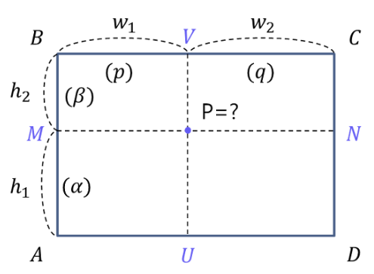
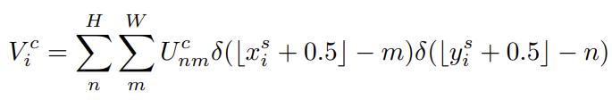
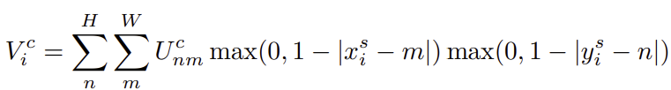
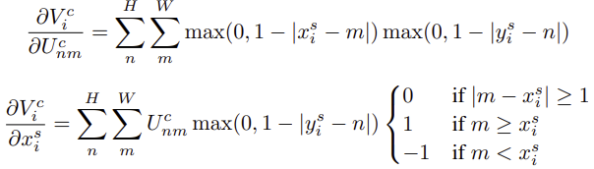
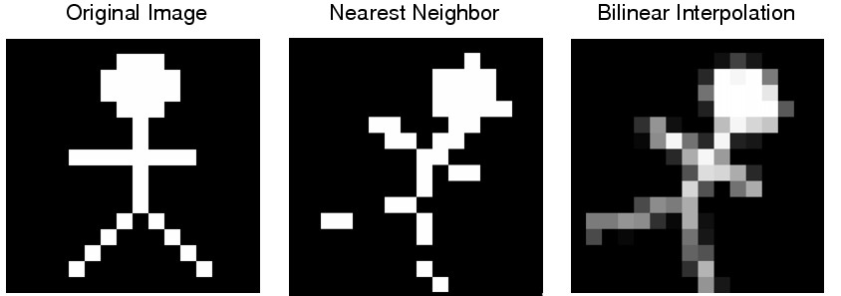
Jaderberg, Max, Karen Simonyan, and Andrew Zisserman. "Spatial transformer networks." Advances in neural information processing systems 28 (2015).
Spatial Transformers
3. Differentiable Image Sampling
Nearest Integer Sampling
Bilinear Sampling
→ linear interpolation on the x, y axes respectively
[ ] : rounding to the nearset integer
Target value
Source value
It is a (sub-)differentiable sampling mechanism so that it is convenient for backpropagation
If non-differentiable, backpropagation can be calculated by dividing it by sections.
https://jamiekang.github.io/2017/05/27/spatial-transformer-networks/
Notes:
Bilinear interpolation – 쌍선형, 이중선형 보간법
It is a (sub-)differentiable sampling mechanism so that it is convenient for backpropagation
allowing loss gradients to flow back not only to the input feature map (6), but also to the sampling grid coordinates
전체 네트워크에서 loss 값을 backpropagation으로 계산하려면 U와 G에 대해 미분 가능해야 한다.
미분 불가능한 구간이 있더라도 구간별로 나눠서 backpropagation을 계산할 수 있다.

Slide 10
Jaderberg, Max, Karen Simonyan, and Andrew Zisserman. "Spatial transformer networks." Advances in neural information processing systems 28 (2015).
Spatial Transformers
Spatial Transformer Networks
The combination of Localisation network, grid generator and sampler form spatial transformer module + CNN achitecture ⇒ Spatial Transformer Network
Spatial transformer module can be dropped into a CNN architecture at any point, and in any number
Learn during the training process to minimize the overall cost function of CNN ⇒ it has little effect on training speed
The knowledge(how to transform) is compressed and cached in the weights of the localisation network during training
It is possible to have multiple spatial transformers in a CNN.
To put the ST layer just before the CNN input : most efficient
Notes:
Why do we need interpolation
회전하기 전에 포인트 => 정수값이 아님

Slide 11
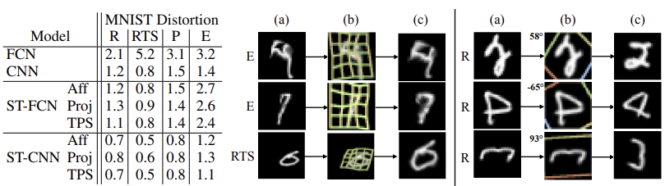

Jaderberg, Max, Karen Simonyan, and Andrew Zisserman. "Spatial transformer networks." Advances in neural information processing systems 28 (2015).
Experiments
1. Distorted MNIST
ST-CNN TPS
ST-CNN Aff
Model
FCN, CNN
ST + FCN
ST + CNN
grid $T_{θ}(G)$
MNIST dataset – distorted in various ways (4)
rotation (R), rotation-translation-scale (RTS), projective transformation (P), elastic warping (E)
As we can see, ST-FCN outperforms FCN and ST-CNN outperforms CNN.
ST-CNN models consistently perform better than ST-FCN models
CNN > FCN ⇒ The CNN models include two max-pooling layers → Maxpooling layer makes spatial invariance high
Spatial transformation : affine (AFF), projective (Proj), thin plate spline transformation (TPS)
Between different classes of transformation, the TPS is the most powerful

Slide 12
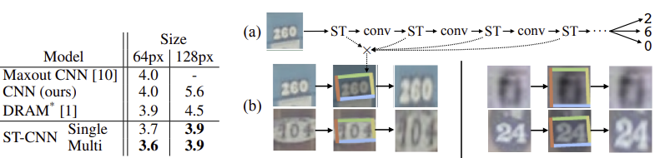
Jaderberg, Max, Karen Simonyan, and Andrew Zisserman. "Spatial transformer networks." Advances in neural information processing systems 28 (2015).
Experiments
2. Street View House Numbers
ST-CNN Multi
This dataset contains around 200k real world images of house numbers
Put ST layer → CNN convolutional stack
ST-CNN Single : Only one ST at the beginning of network
ST-CNN Multi : One ST before each convolutional layer
Affine transformation, bilinear sampler is used
ST-CNN outperforms Maxout and CNN
ST-CNN Multi outperforms ST-CNN Single a bit– 속도 6% 느려짐

Slide 13
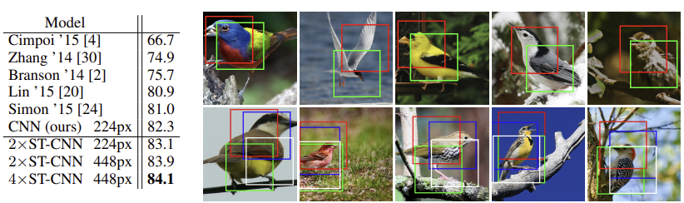
Jaderberg, Max, Karen Simonyan, and Andrew Zisserman. "Spatial transformer networks." Advances in neural information processing systems 28 (2015).
Experiments
3. Fine-Grained Classification
Head
Body
2x ST-CNN
4x ST-CNN
Use a spatial transformer network with multiple transformers in parallel to perform fine-grained bird classification
CUB 200-2011 birds dataset - 200 species of birds, 11,788 images
Strong baseline CNN model : Inception-v2 (ImageNet pre-trained) for classifying 200 species (82.3% accuracy)
2x ST-CNN , 4x ST-CNN : 2 or 4 parallel STs
4x ST-CNN achieves an accuracy of 84.1%, outperforms the baseline by 1.8%
Interesting behaviour : Each box = ST found (without supervision)
2x ST-CNN : red ST – head detector, green – detect central part of the body

Slide 14
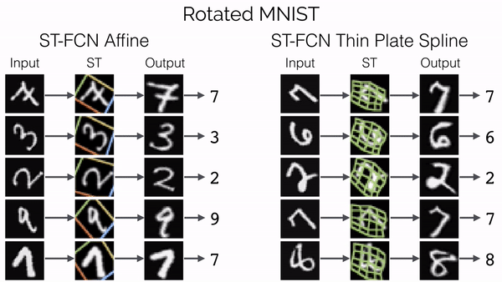
Jaderberg, Max, Karen Simonyan, and Andrew Zisserman. "Spatial transformer networks." Advances in neural information processing systems 28 (2015).
Conclusion
A new self-contained module for neural networks – the spatial transformer
This module can be dropped into a network and perform explicit spatial transformations of features
Differentiable and learnt in an end-to-end fashion – without making any changes to the loss function
While CNNs provide an incredibly strong baseline, they see gains in accuracy using spatial transformers across multiple tasks, resulting in state-of-the-art performance.
https://manjunathbhat9920.medium.com/spatial-transformer-network-82666f184299
https://towardsdatascience.com/review-stn-spatial-transformer-network-image-classification-d3cbd98a70aa
Notes:
Outperforms the state-of-art performance in some tasks
. Furthermore, the regressed transformation parameters from the spatial transformer are available as an output and could be used for subsequent tasks.
While we only explore feed-forward networks in this work, early experiments show spatial transformers to be powerful in recurrent models, and useful for tasks requiring the disentangling of object reference frames.

